Slide 1
Docker basics
By Sameer Sonaikar

Slide 3
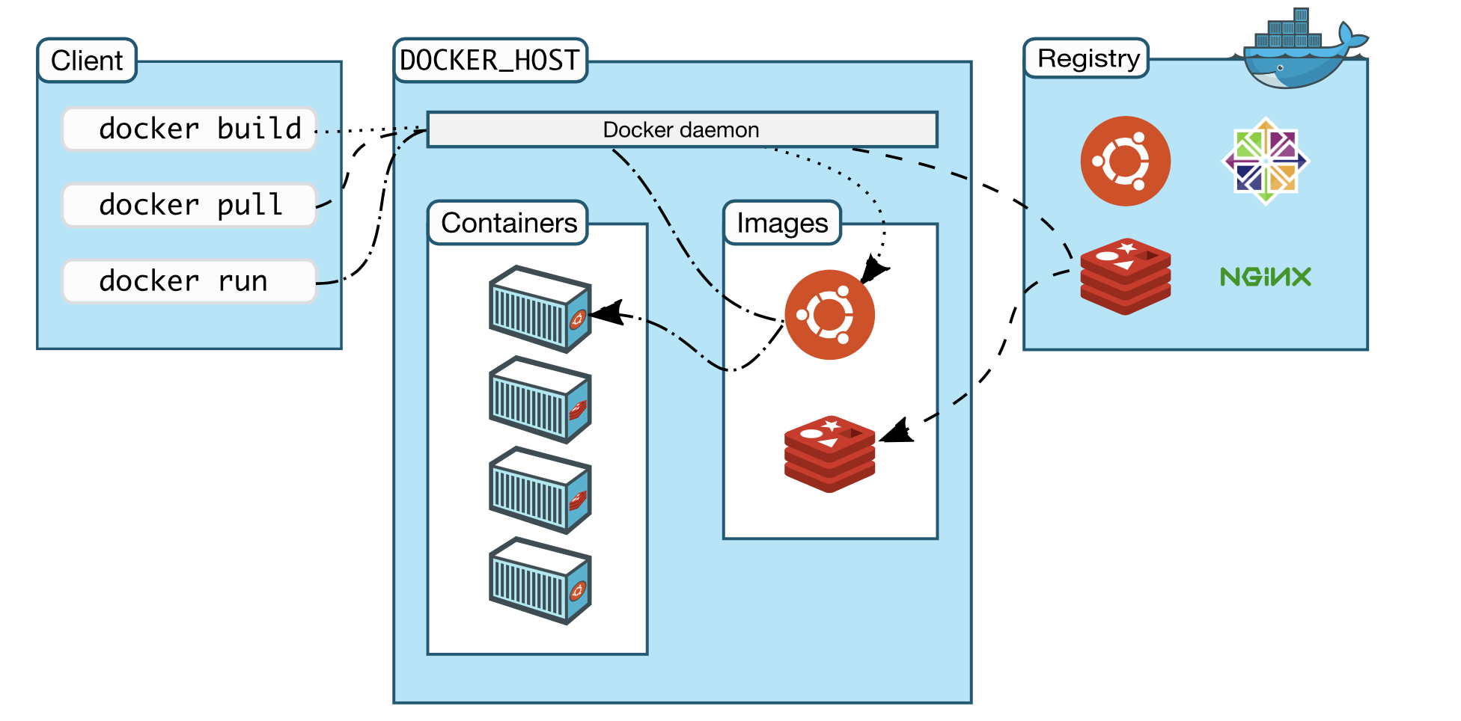
Docker architecture

Slide 4
Underlying technologies
Docker is written in Go and takes advantage of several features of the Linux kernel to deliver its functionality
Namespaces
Docker uses a technology called namespaces to provide the isolated workspace called the container. When you run a container, Docker creates a set of namespaces for that container.
These namespaces provide a layer of isolation. Each aspect of a container runs in a separate namespace and its access is limited to that namespace.

Slide 5
Namespaces
Docker Engine uses namespaces such as the following on Linux:
The pid namespace: Process isolation (PID: Process ID).
The net namespace: Managing network interfaces (NET: Networking).
The ipc namespace: Managing access to IPC resources (IPC: Inter Process Communication).
The mnt namespace: Managing filesystem mount points (MNT: Mount).
The uts namespace: Isolating kernel and version identifiers. (UTS: Unix Timesharing System).

Slide 6
Control groups
Docker Engine on Linux also relies on another technology called control groups (cgroups).
A cgroup limits an application to a specific set of resources.
Control groups allow Docker Engine to share available hardware resources to containers and optionally enforce limits and constraints.
For example, you can limit the memory available to a specific container.

Slide 7
Union file systems
Union file systems, or UnionFS, are file systems that operate by creating layers, making them very lightweight and fast.
Docker Engine uses UnionFS to provide the building blocks for containers.
Docker Engine can use multiple UnionFS variants, including AUFS, btrfs, vfs, and DeviceMapper.

Slide 8
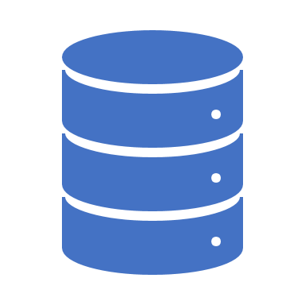
Container format
Docker Engine combines the namespaces, control groups, and UnionFS into a wrapper called a container format.
The default container format is libcontainer.
In the future, Docker may support other container formats by integrating with technologies such as BSD Jails or Solaris Zones.

Slide 9
Docker commands
$ docker --version
Docker version 18.09.1, build 4c52b90
$ docker –help
$ docker pull ubuntu
$ docker images
REPOSITORY TAG IMAGE ID CREATED SIZE
cassandra-backup dev 620412b2c71f 29 hours ago 937MB

Slide 10

Docker networking
Three Networks
Bridge
None
Host
The default bridge network in detail

Slide 11

Basic of docker networking
The basic network primitive in Docker is an Ethernet bridge called "docker0." When Docker boots up on a Linux server, it creates a default docker0 bridge inside the Linux kernel, and docker0 creates a virtual subnet on the Docker host. It can pass packets back and forth between containers on that host.

Slide 12
Docker network
When you install Docker, it creates three networks automatically. You can list these networks using the docker network ls command:
$ docker network ls
NETWORK ID NAME DRIVER SCOPE
831e10603c39 bridge bridge local
76a99bf81c1f host host local
6de387a5956a none null local

Slide 13
Bridge
The bridge network represents the docker0 network present in all Docker installations. Unless you specify otherwise with the docker run --net=<NETWORK> option, the Docker daemon connects containers to this network by default.

Slide 14
Host
The host network adds a container on the hosts network stack. You’ll find the network configuration inside the container is identical to the host.

Slide 15
Default Network
$ docker network ls
$ docker network inspect 831e10603c39
$ docker network inspect bridge
The Engine automatically creates a Subnet and Gateway to the network. The docker run command automatically adds new containers to this network.
$ docker run -itd --name container1 busybox
$ docker run -itd --name container2 busybox
$ docker network inspect bridge

Slide 16
Docker network
"Containers": {
"51ec76e5b2de559af56d47809891fa3370311604b544217019424e54977e985a": {
"Name": "container2",
"EndpointID": "e6499ca0e279241356d70be81ba38d8241ae688f7c8e654e7a3c31607c474fc8",
"MacAddress": "02:42:ac:11:00:04",
"IPv4Address": "172.17.0.4/16",
"IPv6Address": ""
},
"52ebe38b25b141b117f935200ad601136f29862b3b57fda77b9d52fd92ab6755": {
"Name": "container1",
"EndpointID": "d33b178cf841507200e3574feee04fa916a0865e52bd49f7b0a74be06e99518d",
"MacAddress": "02:42:ac:11:00:03",
"IPv4Address": "172.17.0.3/16",
"IPv6Address": ""
},
"558f91e91a50eb8fac04cd19faf19dfc44a46e6088a1b2199baa85d6c2853212": {
"Name": "suspicious_elbakyan",
"EndpointID": "7b5938c482724cc2cfb89fd8217ebba5a3b06f234d64f7f20dad7c9718e90aeb",
"MacAddress": "02:42:ac:11:00:02",
"IPv4Address": "172.17.0.2/16",
"IPv6Address": ""
}
},

Slide 17
Docker network
The docker network inspect command above shows all the connected containers and their network resources on a given network. Containers in this default network are able to communicate with each other using IP addresses

Slide 18
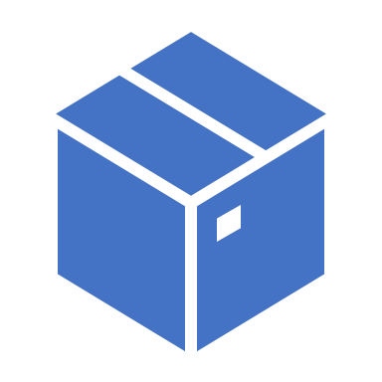
Docker storage

Slide 19
Known file system
Linux:
• ext3, ext4, xfs, zfs
Windows:
• FAT, NTFS

Slide 20
Why docker file system
Docker is successful because of shipping container
• Shipping container is made possible by docker image
• Docker image uses file system • To maintain file structure specified by user (Dockerfile) • To share this file structure to multiple container instantiations

Slide 21
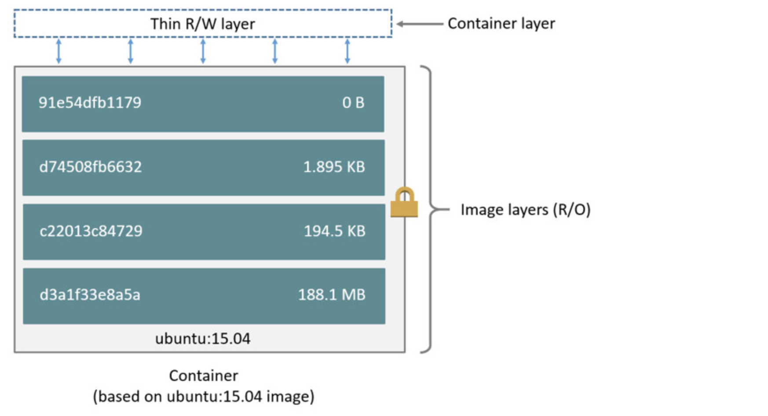
Docker file system

Slide 22
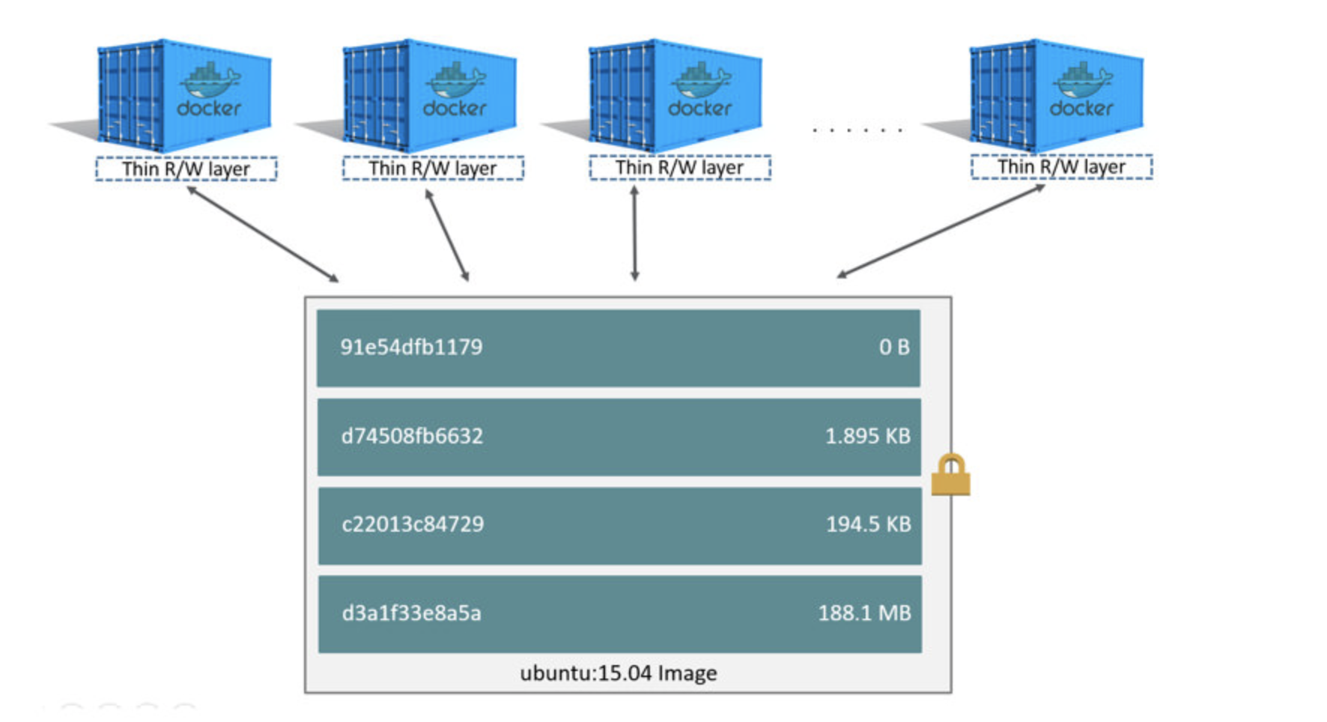
Docker read/write

Slide 23
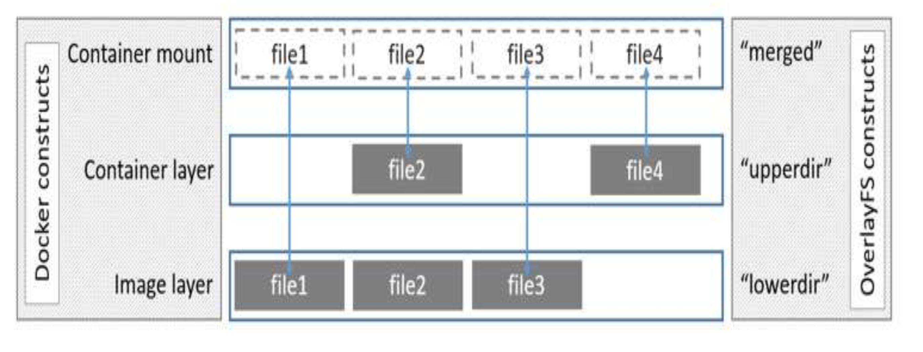
Docker image file system (overlay)

Slide 24
Container size on disk
$ docker ps –s
size: the amount of data (on disk) that is used for the writable layer of each container.
virtual size: the amount of data used for the read-only image data used by the container plus the container’s writable layer size. Multiple containers may share some or all read-only image data. Two containers started from the same image share 100% of the read-only data, while two containers with different images which have layers in common share those common layers. Therefore, you can’t just total the virtual sizes. This over-estimates the total disk usage by a potentially non-trivial amount.

Slide 25
The copy-on-write (CoW) strategy
Copy-on-write is a strategy of sharing and copying files for maximum efficiency. If a file or directory exists in a lower layer within the image, and another layer (including the writable layer) needs read access to it, it just uses the existing file. The first time another layer needs to modify the file (when building the image or running the container), the file is copied into that layer and modified. This minimizes I/O and the size of each of the subsequent layers.

Slide 26

Docker sizes
$docker images
$docker history <image>
$ docker system df
SSonaikar-macpro:bin sameer.sonaikar$ docker history k8s.gcr.io/k8s-dns-kube-dns-amd64:1.14.8
IMAGE CREATED CREATED BY SIZE
80cc5ea4b547 13 months ago /bin/sh -c #(nop) ENTRYPOINT ["/kube-dns"] 0B
<missing> 13 months ago /bin/sh -c #(nop) ADD file:42d277e640084fda2… 46.3MB
<missing> 13 months ago /bin/sh -c #(nop) MAINTAINER Bowei Du <bowe… 0B
<missing> 14 months ago /bin/sh -c #(nop) CMD ["/bin/sh"] 0B
<missing> 14 months ago /bin/sh -c #(nop) ADD file:2b00f26f6004576e2… 4.14MB
Note: The <missing> lines in the docker history output indicate that those layers were built on another system and are not available locally. This can be ignored.

Slide 27
Copying makes containers efficient
When you start a container, a thin writable container layer is added on top of the other layers. Any changes the container makes to the filesystem are stored here. Any files the container does not change do not get copied to this writable layer. This means that the writable layer is as small as possible.
When an existing file in a container is modified, the storage driver performs a copy-on-write operation. The specifics steps involved depend on the specific storage driver. For the aufs, overlay, and overlay2 drivers, the copy-on-write operation follows this rough sequence:
Search through the image layers for the file to update. The process starts at the newest layer and works down to the base layer one layer at a time. When results are found, they are added to a cache to speed future operations.
Perform a copy_up operation on the first copy of the file that is found, to copy the file to the container’s writable layer.
Any modifications are made to this copy of the file, and the container cannot see the read-only copy of the file that exists in the lower layer.

Slide 28

Write operations
Containers that write a lot of data consume more space than containers that do not. This is because most write operations consume new space in the container’s thin writable top layer.
Note: for write-heavy applications, you should not store the data in the container. Instead, use Docker volumes, which are independent of the running container and are designed to be efficient for I/O. In addition, volumes can be shared among containers and do not increase the size of your container’s writable layer.

Slide 29
Use volumes
Volumes are the preferred mechanism for persisting data generated by and used by Docker containers. While bind mounts are dependent on the directory structure of the host machine, volumes are completely managed by Docker. Volumes have several advantages over bind mounts:
Volumes are easier to back up or migrate than bind mounts.
You can manage volumes using Docker CLI commands or the Docker API.
Volumes work on both Linux and Windows containers.
Volumes can be more safely shared among multiple containers.
Volume drivers let you store volumes on remote hosts or cloud providers, to encrypt the contents of volumes, or to add other functionality.
New volumes can have their content pre-populated by a container.
In addition, volumes are often a better choice than persisting data in a container’s writable layer, because a volume does not increase the size of the containers using it, and the volume’s contents exist outside the lifecycle of a given container.

Slide 30
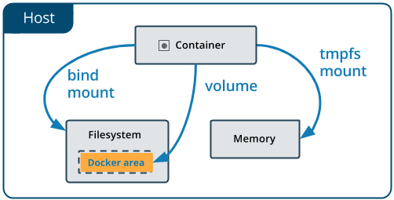
Use volumes
If your container generates non-persistent state data, consider using a tmpfs mount to avoid storing the data anywhere permanently, and to increase the container’s performance by avoiding writing into the container’s writable layer.

Slide 31
Create and Manage volumes
$docker volume create my-vol
$docker volume ls
$docker volume inspect my-vol
$ docker volume rm my-vol
root@ububtu-s1:/var/lib/docker# docker volume inspect my-vol
[
{
"CreatedAt": "2019-02-02T03:27:38Z",
"Driver": "local",
"Labels": {},
"Mountpoint": "/var/lib/docker/volumes/my-vol/_data",
"Name": "my-vol",
"Options": {},
"Scope": "local"
}
]

Slide 32
Docker volumes
If you start a container with a volume that does not yet exist, Docker creates the volume for you.
$ docker run -d --name devtest --mount source=myvol2,target=/app nginx:latest
root@ububtu-s1:/var/lib/docker# docker inspect volume myvol2
[
{
"CreatedAt": "2019-02-02T03:32:52Z",
"Driver": "local",
"Labels": null,
"Mountpoint": "/var/lib/docker/volumes/myvol2/_data",
"Name": "myvol2",
"Options": {},
"Scope": "local"
}
]

Slide 33
Remove volumes
Stop the container and remove the volume. Note volume removal is a separate step.
$ docker container stop devtest
$ docker container rm devtest
$ docker volume rm myvol2

Slide 34
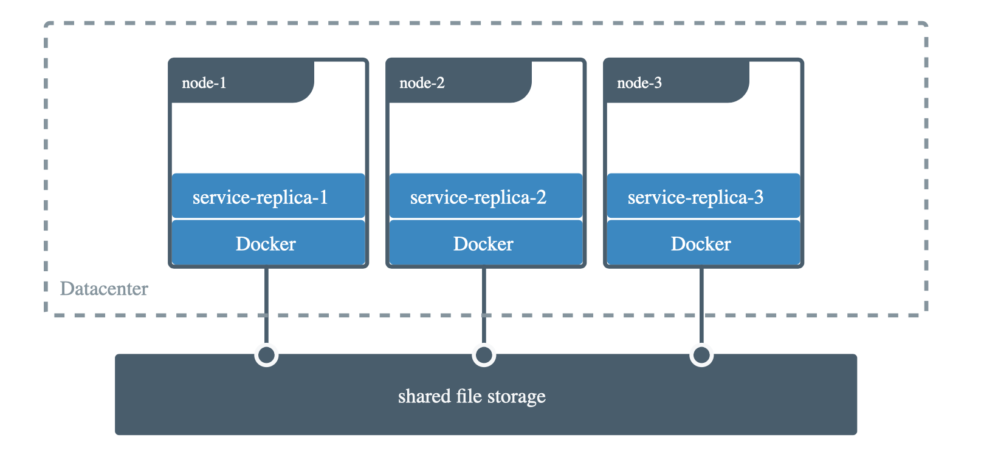
Share data among machines
When building fault-tolerant applications, you might need to configure multiple replicas of the same service to have access to the same files.

Slide 35
Example
$ docker plugin install --grant-all-permissions vieux/sshfs
$ docker volume create --driver vieux/sshfs -o sshcmd=test@node2:/home/test -o password=testpassword sshvolume
$ docker run -d --name sshfs-container --volume-driver vieux/sshfs --mount src=sshvolume,target=/app,volume-opt=sshcmd=test@node2:/home/test,volume-opt=password=testpassword nginx:latest

Slide 36
Data volume containers:
While Docker will never delete data in volumes (unless you delete the associated container with docker rm -v), volumes that are not referenced by any docker container are called dangling volumes. Those dangling volumes are difficult to get rid of and difficult to access.
This means that as soon as the last container using a volume is deleted, the data volume becomes dangling and its content difficult to access.
In order to prevent those dangling volumes, the trick is to create an additional docker container using the data volume you want to remain ; so that there will always be at least that docker container referencing the volume. This way you can delete the docker container running the wordpress app without losing the ease of access to that data volume content.

Slide 37
Backup a container
Launch a new container and mount the volume from the dbstore container
Mount a local host directory as /backup
Pass a command that tars the contents of the dbdata volume to a backup.tar file inside our /backup directory.
$ docker run -it -v /dbdata --name dbstore ubuntu bash
$ docker run --rm --volumes-from dbstore -v $(pwd):/backup ubuntu tar cvf /backup/backup.tar /dbdata
OR below method using explicit volume
$ docker volume create dbstore
$docker run --rm --mount src=dbstore,target=/dbdata -v $(pwd):/backup ubuntu tar cvf /backup/backup.tar /dbdata

Slide 38
Restore container from backup
With the backup just created, you can restore it to the same container, or another that you made elsewhere.
$ docker run -v /dbdata --name dbstore2 ubuntu /bin/bash
$ docker run --rm --volumes-from dbstore2 -v $(pwd):/backup ubuntu bash -c "cd /dbdata && tar xvf /backup/backup.tar --strip 1”
OR below command
$docker run --rm --mount src=dbstore,target=/dbdata -v $(pwd):/backup ubuntu bash -c "cd /dbdata && tar xvf /backup/backup.tar --strip 1"

Slide 39
Remove volumes
A Docker data volume persists after a container is deleted. There are two types of volumes to consider:
Named volumes have a specific source form outside the container, for example awesome:/bar
Anonymous volumes have no specific source so when the container is deleted, instruct the Docker Engine daemon to remove them.

Slide 40
Remove anonymous volumes
To automatically remove anonymous volumes, use the --rm option. For example, this command creates an anonymous /foovolume. When the container is removed, the Docker Engine removes the /foo volume but not the awesome volume.
$ docker run –rm -v /foo -v awesome:/bar busybox top
Remove all volumes
$ docker volume prune

Slide 41
Backup/restore process:
Install local-persist on ubuntu: curl -fsSL https://raw.githubusercontent.com/MatchbookLab/local-persist/master/scripts/install.sh | sudo bash Ensure local-persist plugin is running: systemctl status docker-volume-local-persist Create docker volume: (DB files are available at /root/data) cd /root/data; touch index.html; docker volume create -d local-persist -o mountpoint=/root/data --name=dbstore Create backup in local directory: (/root/mydata) cd /root/mydata docker run --mount src=dbstore,target=/dbdata -v $(pwd):/backup ubuntu tar cvf /backup/backup.tar /dbdata
Delete files from /root/data directory: rm -rf /root/data/index.html Restore from backup (/root/mydata): docker run --rm --mount src=dbstore,target=/dbdata -v $(pwd):/backup ubuntu bash -c "cd /dbdata && tar xvf /backup/backup.tar --strip 1" Ensure files are restored: ls -l /root/data

Slide 42
AWS S3 backend for volume
This is nice coverup if you want to try S3 as docker-volume backup.
https://blog.vizuri.com/practical-persistent-cloud-storage-for-docker-in-aws-using-rexray-pt-1

